Slide 1
Title: SQL Injection Attacks and Their Prevention in Web Applications
Name : Fatima ramzan
Roll no : BITF24A029
SECTION: AFTERNOON
SUBJECT: INFORMATION SECURITY

Slide 2
INTRODUCTION
Web applications store sensitive data in databases.
Poor input validation can lead to SQL Injection attacks.
Attackers manipulate SQL queries using user input.
This project shows attack and prevention techniques.

Slide 3
Problem Statement
Many web applications are insecure due to weak input validation.
SQL Injection allows attackers to:
Bypass login systems
Access confidential data
Modify or delete database records

Slide 4
What is SQL Injection?
SQL Injection is a web security vulnerability.
It occurs when attackers insert malicious SQL code.
It changes the behavior of database queries.
It is one of the most dangerous web attacks.

Slide 5
How SQL Injection Works
User input is directly included in SQL query.
Attacker modifies input to change query logic.
Database executes unintended commands.
Leads to unauthorized access.

Slide 6
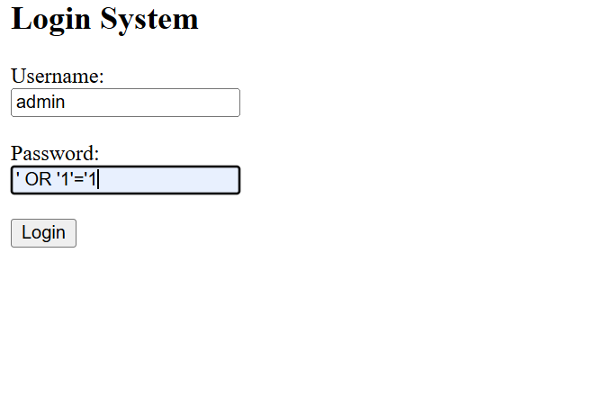
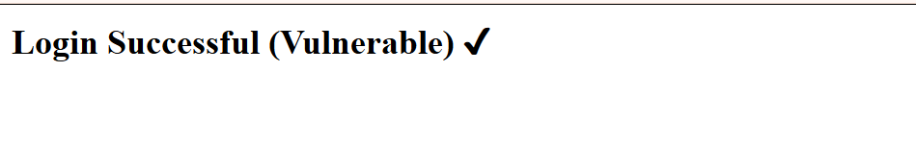
Attack Example (Demo Input)

Slide 7
Vulnerable SQL Query
SELECT * FROM users WHERE username='$user' AND password
='$pass';
Direct insertion of user input
No validation or sanitization
Highly insecure

Slide 8
Impact of SQL Injection
Unauthorized login access
Data theft
Database modification or deletion
Complete system compromise

Slide 9
Prevention Techniques
Prepared Statements
Parameterized Queries
Input Validation
Least Privilege Principle

Slide 10
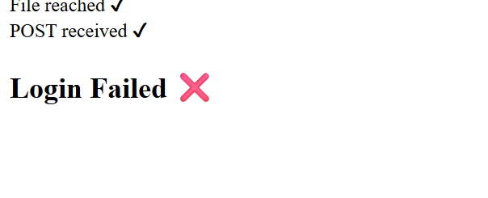
Secure example

Slide 11
Secure Code Example
$stmt = $conn->prepare("SELECT * FROM users WHERE username=? AND password=?");
$stmt->bind_param("ss", $user, $pass);
Input treated as data only
Prevent query manipulation
Secure against sql injection

Slide 12
Working
Vulnerable system allows attack using special input
Secure system blocks malicious input
Demonstration shows difference clearly
Both versions tested in project

Slide 13
conclusion
SQL Injection is a serious security threat
It occurs due to unsafe coding practices
Secure coding prevents attacks effectively
Prepared statements are the best solution

Slide 14

Thank you

